Slide 1
AWS PROJECT1 :-”Hello world”Serverless API .
Go to the aws management console then log in with your credentials
Then go to the aws lamda click on create function
Then add your code in python and then deploy it

Slide 2
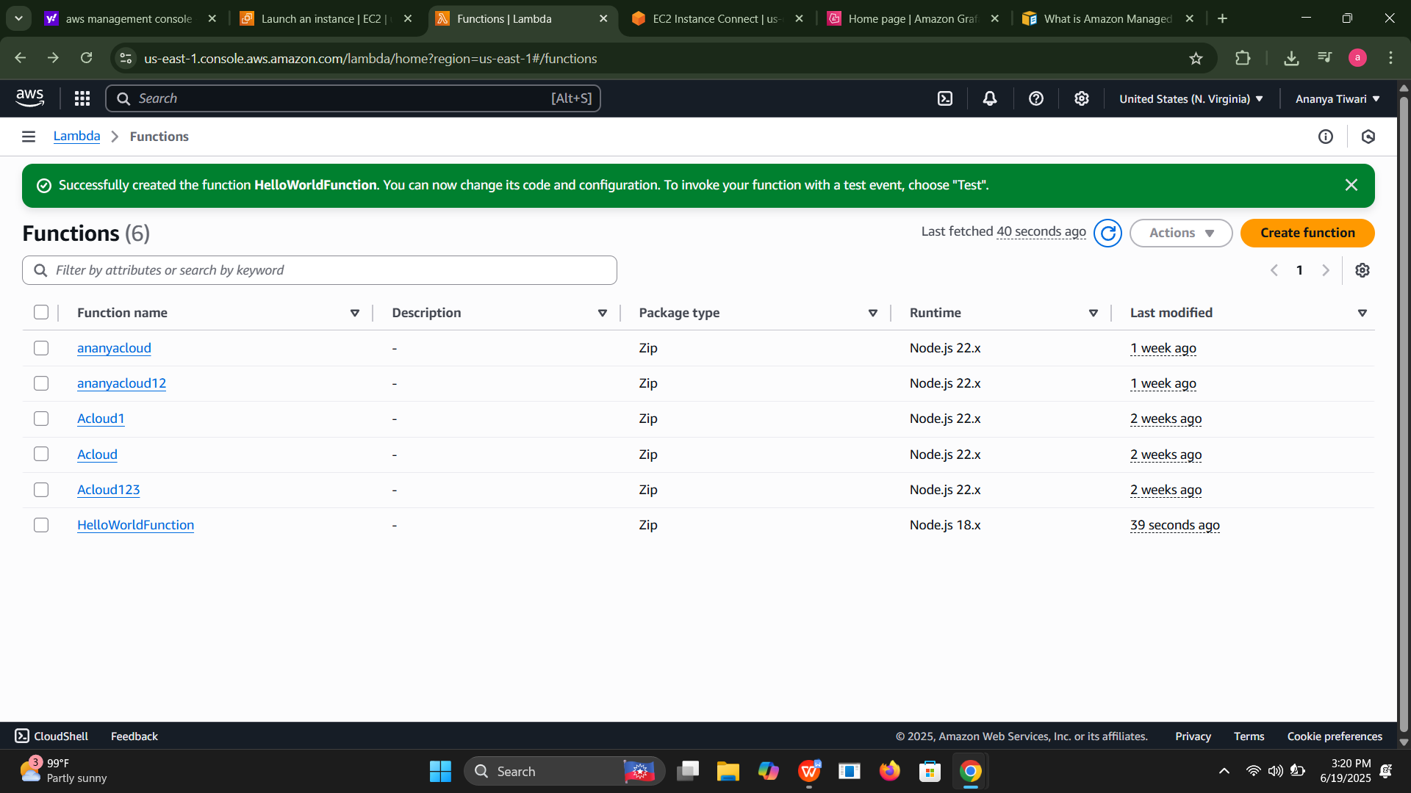
HOW TO CREATE A FUNCTION IN LAMBDA

Slide 3
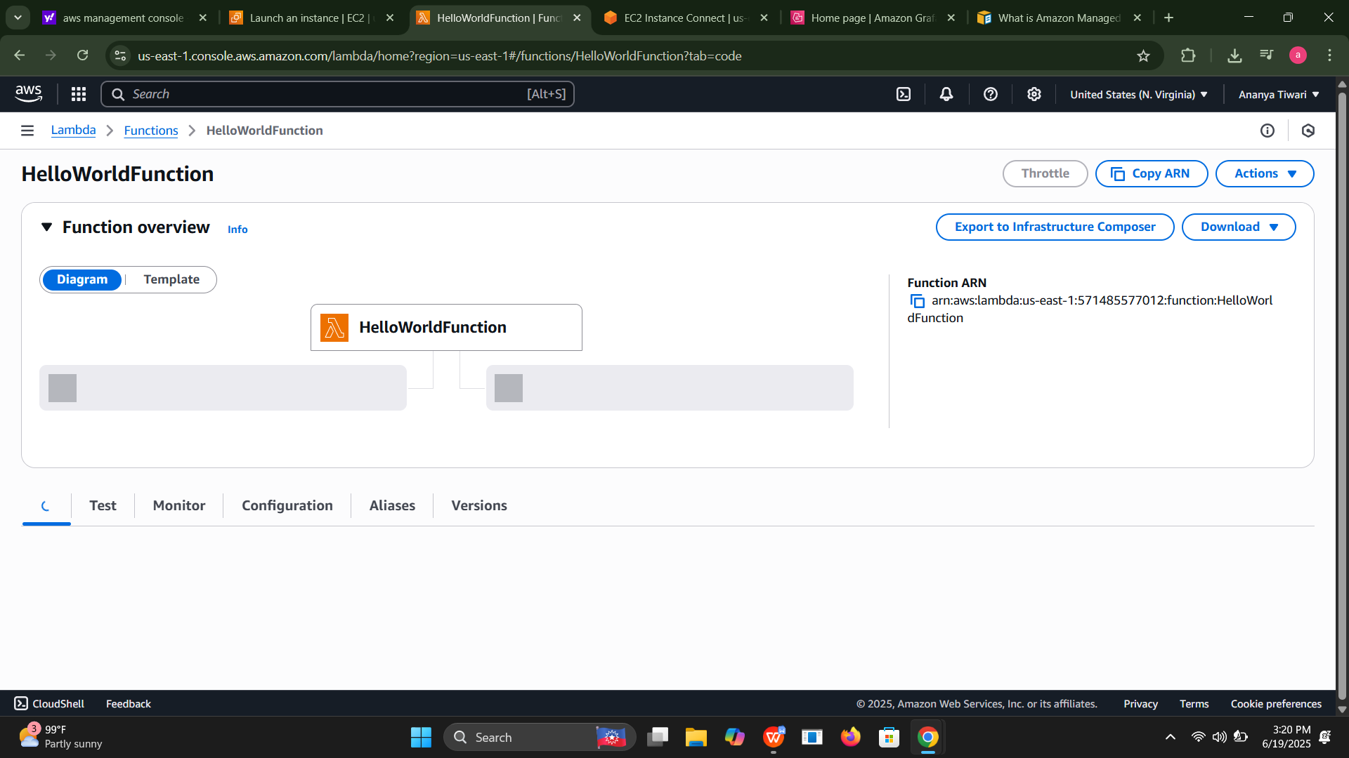
THEN WRITE THE LAMBDA CODE IN AWS

Slide 4
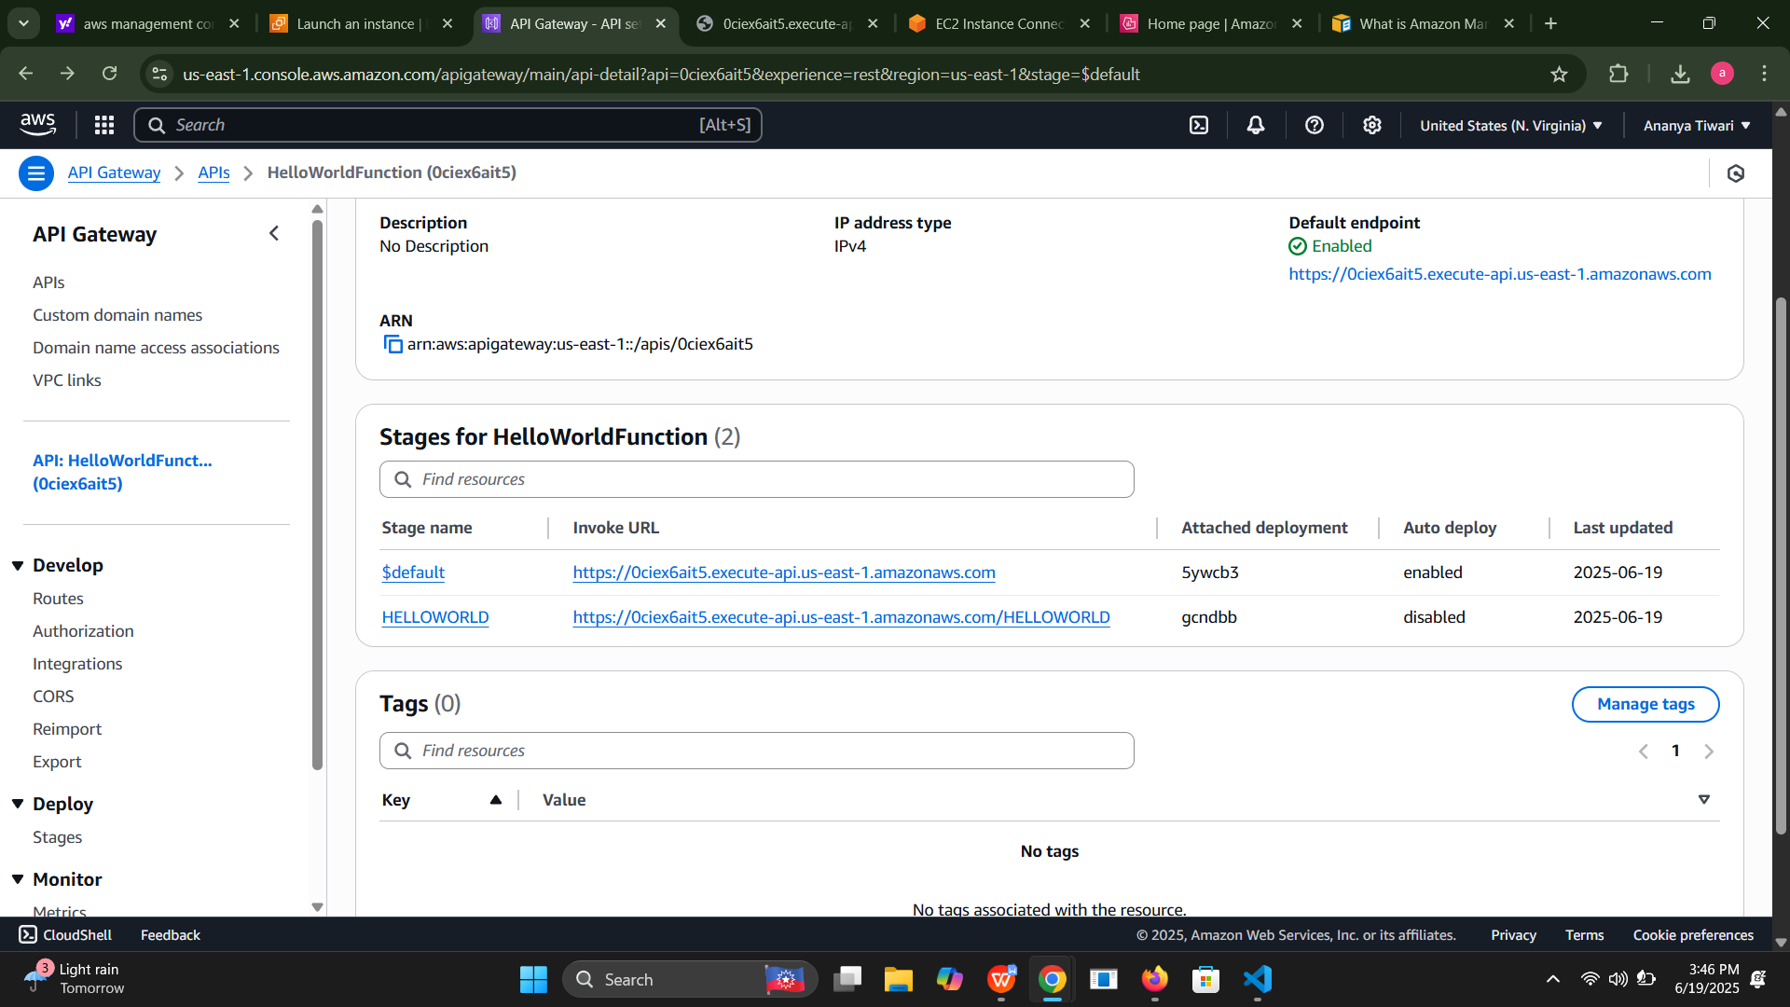
CREATE API GATEWAY

Slide 5
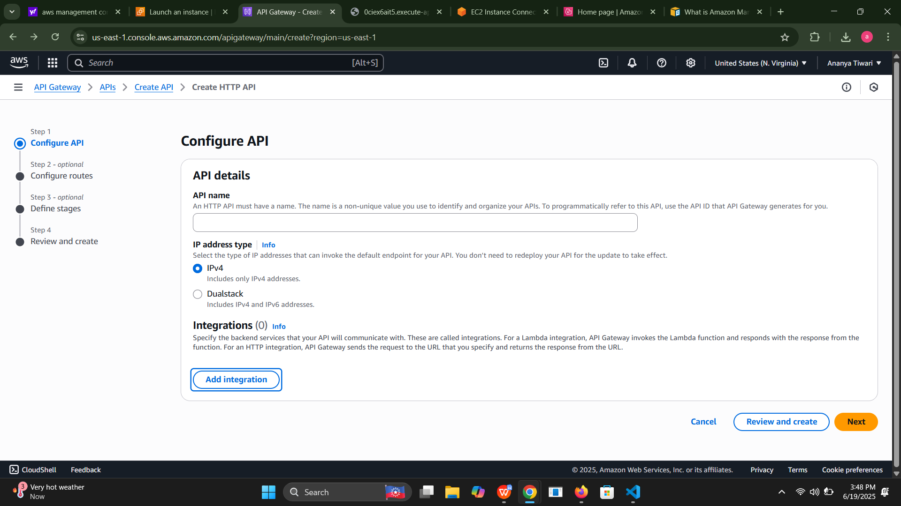
THERE ARE FOLLOWING STEPS HOW TO CREATE A GATAWEAY :- GO TO THE NEXT

Slide 6
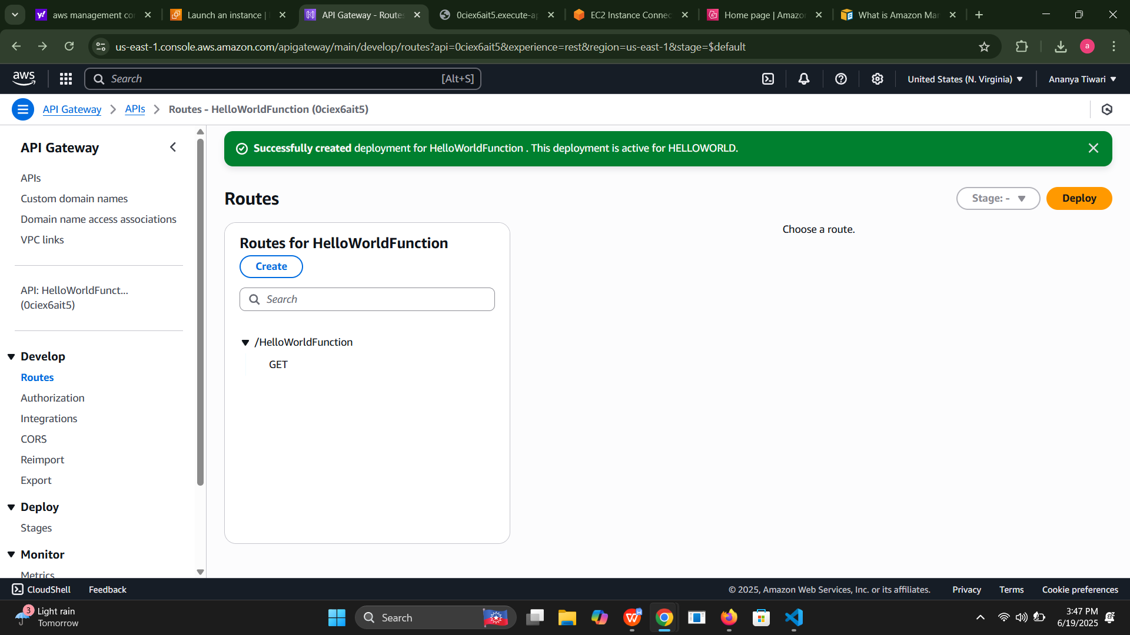
THEN HOW TO DO DEPLOY IN AWS AS YOU CAN SEE in this following picture that after crating you have to deploy as you can see that it is being deployed .

Slide 7
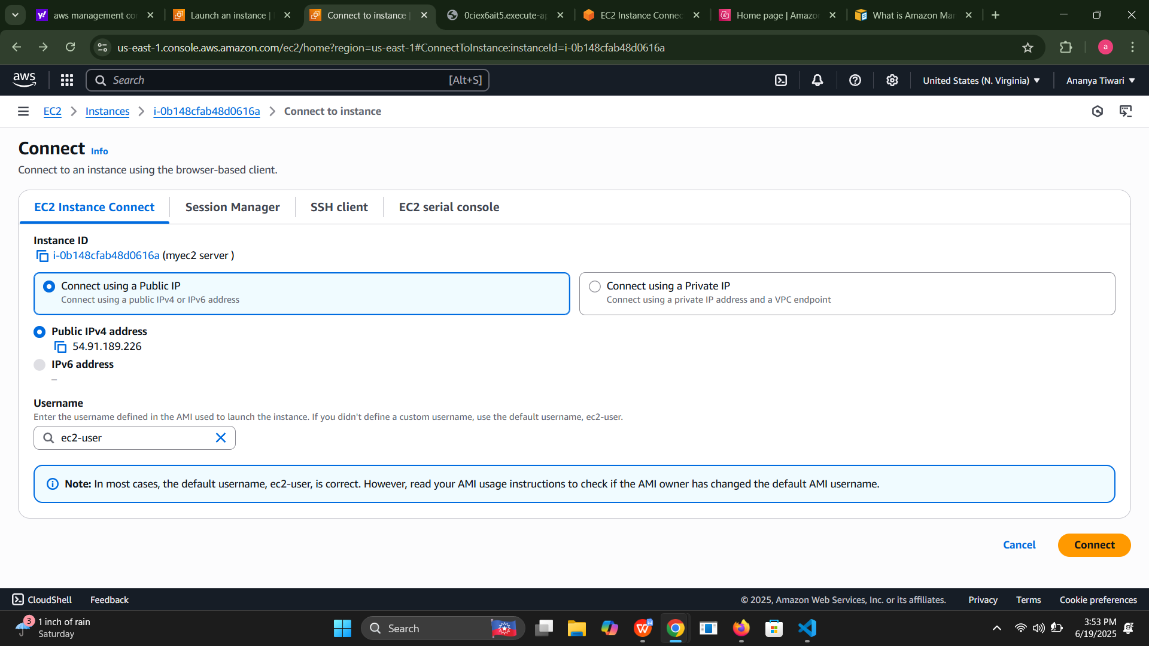
Then go to the ec2 instance and make your instance and them connect t0 that instance

Slide 8
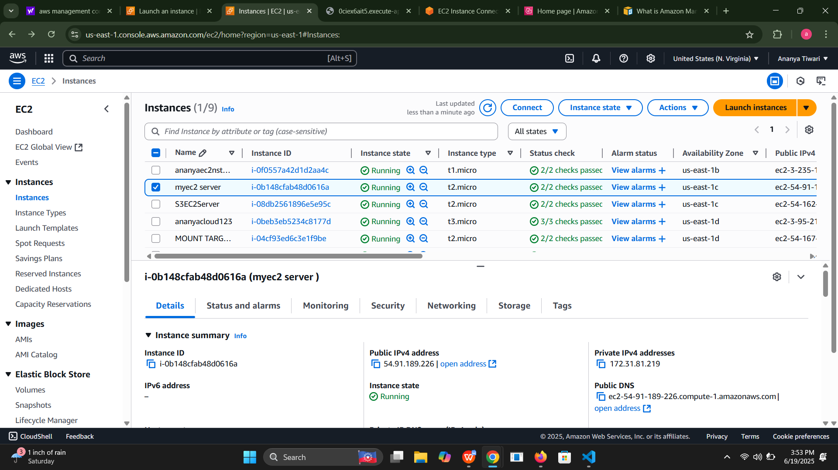
YOU CAN SEE THAT THERE IS A INTANCE WHICH IS BEING LAUNCED UNDER THE FOLLOWING PICTURE WHICH IS BEING WITH BLUE COLOR .

Slide 9
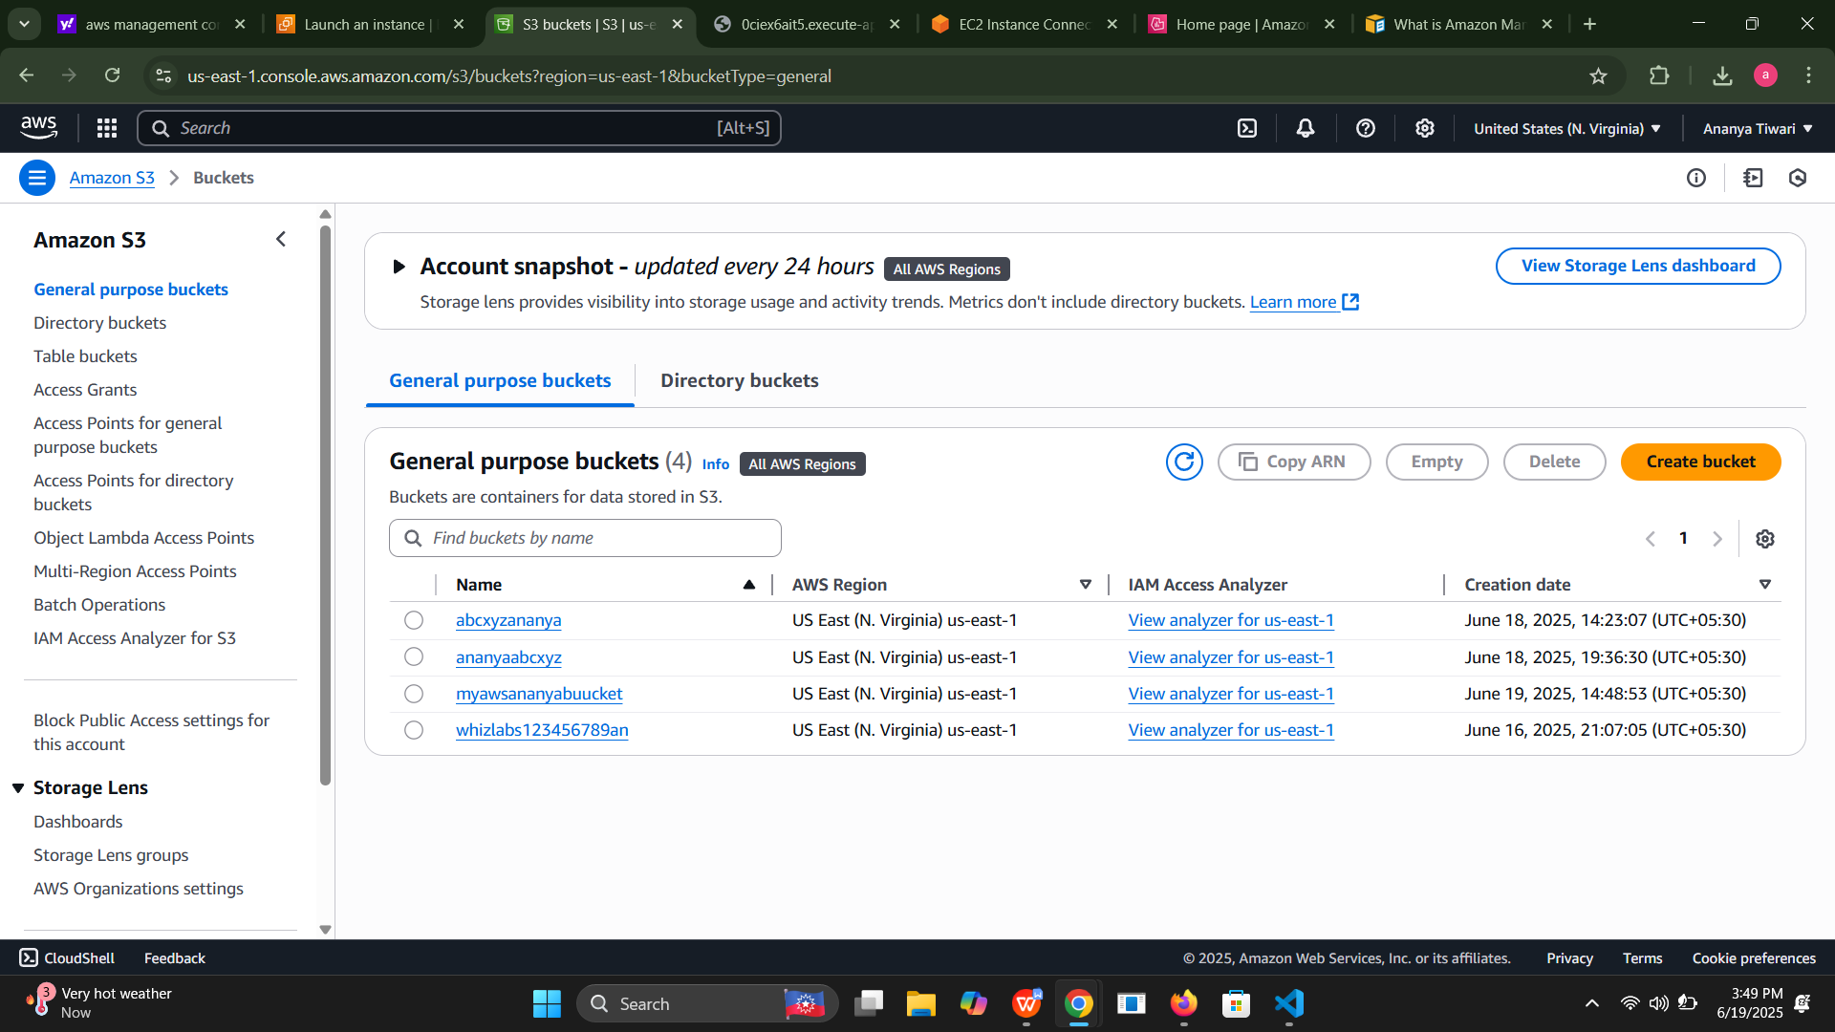
S3 BUCKET

Slide 10
HOW TO CREATE a bucket there is a picture in aws how to make it

